Slide 1
INTRODUCTION OF
CENTER FOR STUDENT WELL-BEING
Center for Student Well-Being：https://csw.ntu.edu.tw/
Version of June 113

Slide 2
Center for Student Well-Being 學輔中心
Founded in Feb. 2021
Consists of 1 Director, 1 Counselor, and 11 Consulting Specialists Stationed in every college
Role of the Center
serve as students’ advisors for campus adaptation
provide consultations as primary prevention interventions
coordinate relevant resources and arrange referrals

Slide 4
off-campus resources
Consulting Specialist: Our Role and Work
Reservation / walk in
Social Welfare Resources
Consulting Specialists
Staff Referral
Student
Assessment
Empowerment
Referral arrangement
Medical services
Other off-campus resources
On-campus resources
College / department faculty
Living resources
Learning resources
Other On-Campus Resources
Psychological resources
Economic resources
SSC, Dorm, GOCFS, OIA
Student Counseling Center
Office of Academic Affairs
Office of Student Affairs
Teacher , Teaching assistants , Peers

Slide 6
Under what circumstances is a referral appropriate?
There is student irregularity in classroom attendance/exams/reports.
01.
The student has had academic warnings and has mentioned wanting to take a leave of absence.
02.
Any other else……？
The student exhibits other abnormal behaviors or circumstances.
03.
The student has incidents requiring reporting, such as concerns about suicide or harming others.
04.

Slide 7
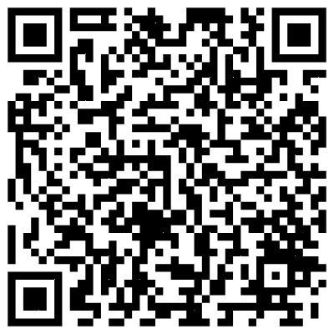
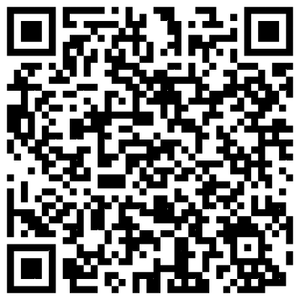
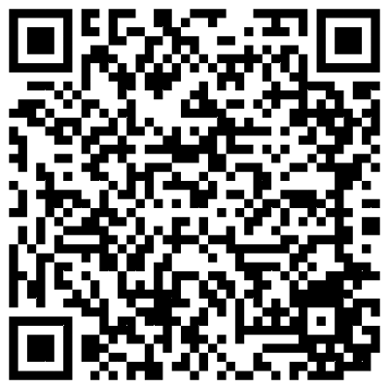
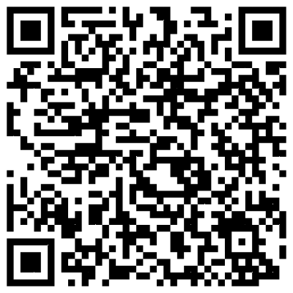
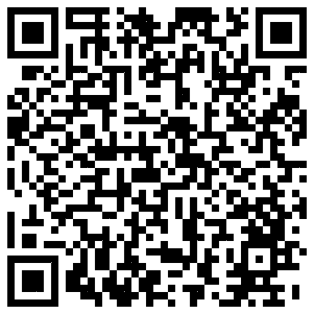
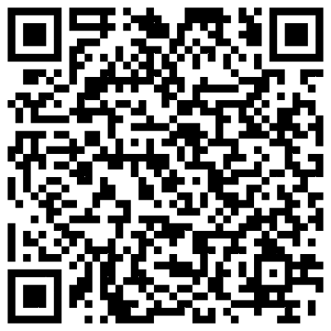
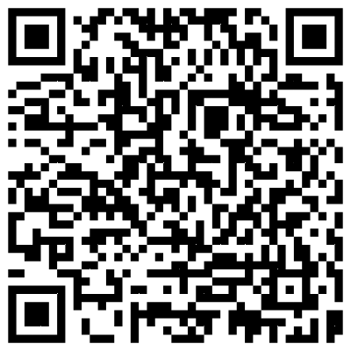
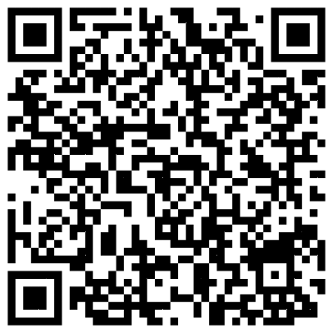
Hotlines
24/7 hotline within the campus
Student Safety Center | 3366-9119
Campus Security | 3366-9110
Other student consulting resources available on campus.
 | Student Counseling Center | 3366-2181 |  | Student Housing Service | 3366-2266
 | Health Center | 3366-9595 |  | Student Assistant Division | 3366-2050
 | Office of International Affairs | 3366- 2007 |  | Overseas Student Advising Division | 3366-3232
 | Gender Equity Education Committee | 3366-9607 |  | Indigenous Student Resource Center | 3366-6605
24/7 hotline outside the campus
Ministry of Health and Welfare's 'Peace of Mind Hotline | 1925
International Lifeline hotline | 1995

Slide 8
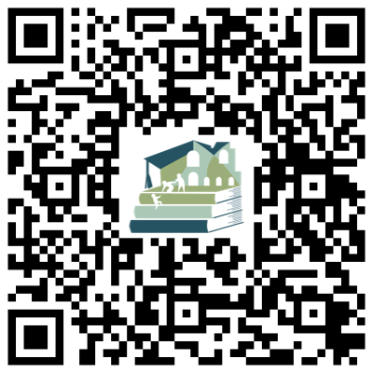
Contact us
Address：Room 102, Mathematics Research Center Building
Contact：（02）3366 – 7173
Email：ntucsw@ntu.edu.tw
Wish you a wonderful journey in NTU!

