Slide 1


INTRODUCTION OF
CENTER FOR STUDENT WELL-BEING
& STUDENT SAFETY CENTER
Yu-Hao Tseng & Tzu-Ming Lin
Consulting Specialist, Center for Student Well-Being, NTU
Center for Student Well-Being：https://csw.ntu.edu.tw/
Student Safety Center：https://ssc.ntu.edu.tw/
Notes:
Hello everyone, we are consulting specialists from Center for Student Well-Being.
We’re going to present a brief introduction of Center for Student Well-Being and Student Safety Center,
So that you will know how to contact us and when to contact us.

Slide 2


Student Safety Center 校安中心
Provide immediate interventions to students in emergency
Staff on duty 24 hours a day, 7 days a week
Promote safety education and national defense education
Emergencies that require assistance from school staff
During non-working hours
Notes:
Student safety center provides immediate interventions to students who are in emergency. We have staff on duty 24 hours a day, 7 days a week.
Besides, student safety center also promotes safety education and national defense education on campus.
So, if you or your friends encounter some emergencies that require assistance from school staff, you may make a call to student safety center, even if it’s during non-working hours.

Slide 3
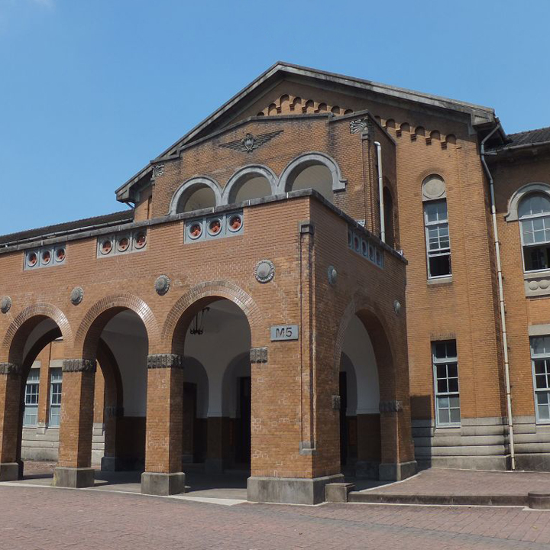
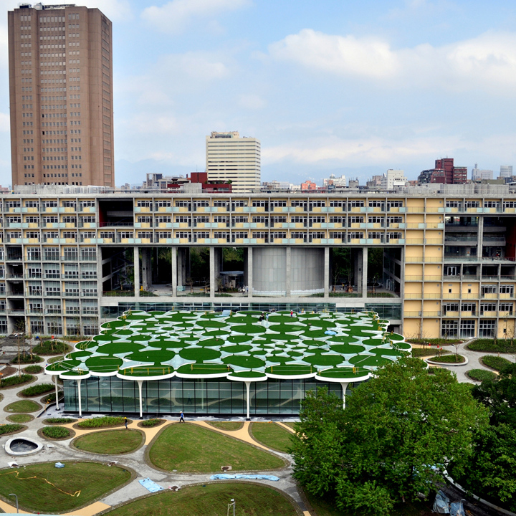
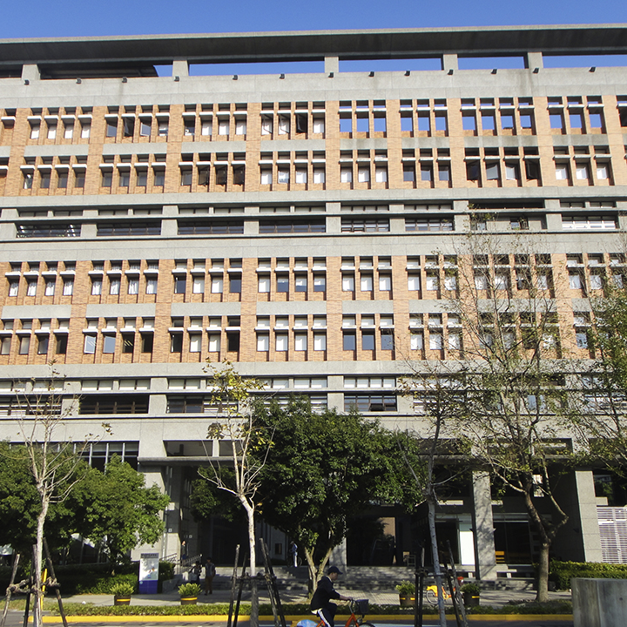
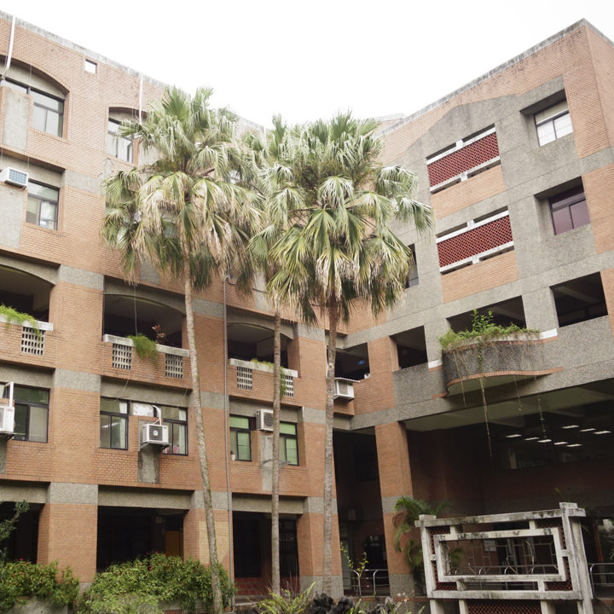
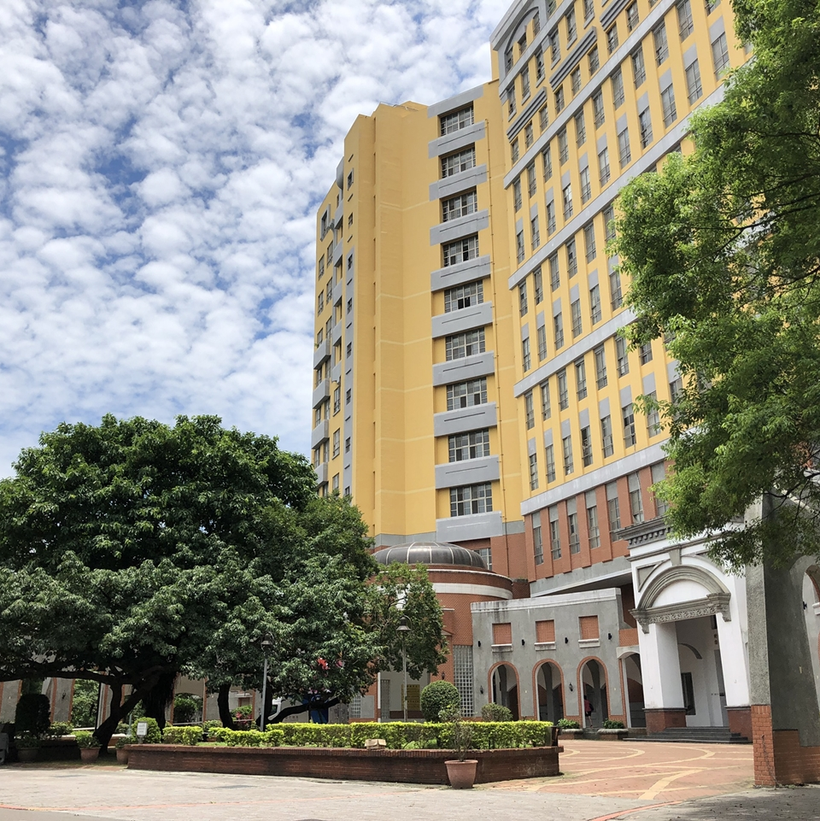
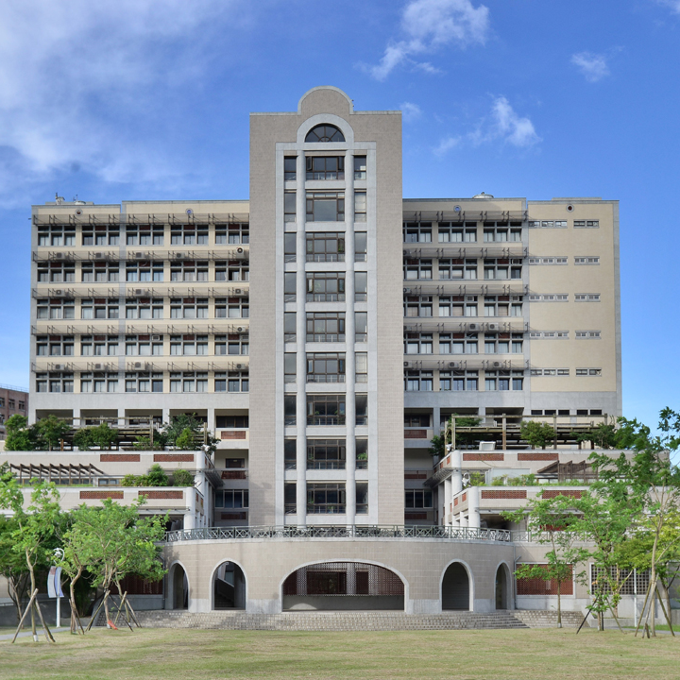
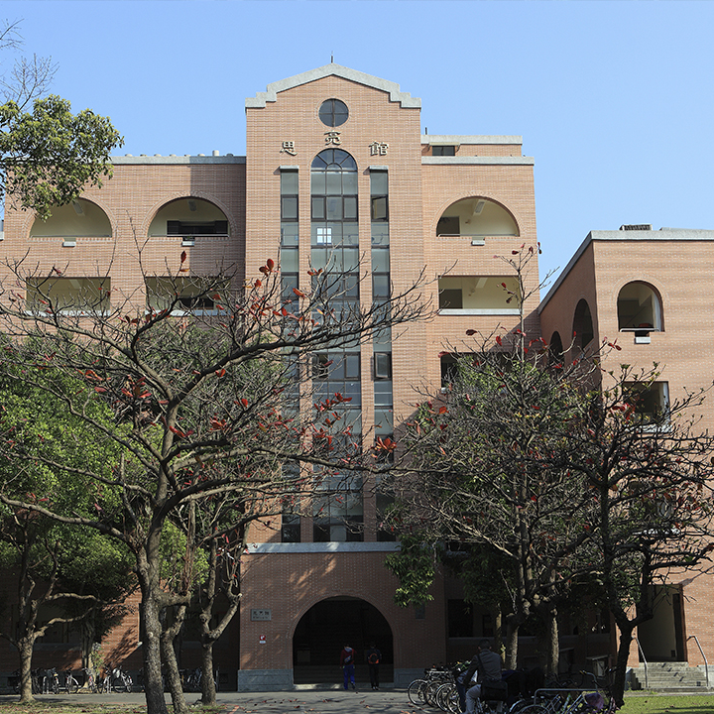
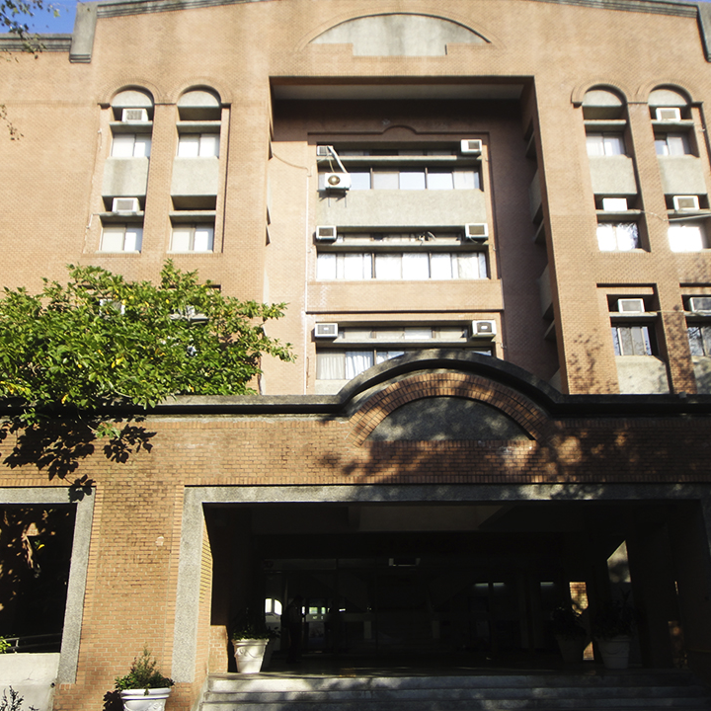
Center for Student Well-Being 學輔中心
Founded in Feb. 2021
Consists of 1 Director, 1 Counselor, and 6 Consulting Specialists stationed in 8 colleges, including:
Social
Science
Bio-resources
& Agriculture
Liberal Arts
Law
Electrical
Engineering
& Computer
Science
Life
Science
Management
Science
Notes:
Next comes the Center for Student Well-Being.
Center for student well-being was founded last year, and currently consists of 1 director, 1 counselor, and 6 consulting specialists.
The consulting specialists are respectively stationed in 8 colleges, including: college of….

Slide 4



Consulting Specialist: Our Role and Work
Primary Prevention
Connection & Coordination
Rooted in College
Notes:
The consulting specialists serve as students’ advisors for campus adaptation.
After understanding students’ needs and situations, the consulting specialists will coordinate relevant resources and arrange referrals, thereby assisting and empowering the students to solve their problems.
In addition, since we are stationed in colleges, we are very accessible to students in need. You can easily reach us through email or just walking in our office.

Slide 5
Consulting Specialist: Our Role and Work
Primary intervention
Homeroom Teacher
Learning resources
Consulting Specialists
Assessment
Empowerment
Referral arrangement
Financial Aids
College / department faculty
Secondary/Tertiary intervention
Community resources
OIA
Student Counseling Center
Individual counseling
Groups & workshops
Speech & forum
Student Safety Center
Medical services
Notes:
This figure can give you an overall understanding of the counseling network at NTU.
As part of the primary intervention, the consulting specialists can collaborate with faculties within the school system, and provide students with assessment and empowerment.
We are also likely to arrange referrals according to students’ needs. For example, if you have difficulties in curriculum, we will introduce some learning resources in Office of Academic Affairs. And if we find that you have serious mental health issues and you would like to have individual counseling, we will introduce you to the Student Counseling Center.
So in fact, there are plenty of sectors which can offer assistance to students on the campus, such as homeroom teacher, college faculty, office of international affairs, office of academic affairs, student counseling center, and so forth.
If you are familiar with all of the sectors and resources at NTU, you can just go visit the right person who can offer you assistance. Otherwise, please feel free to contact us. We, the consulting specialists, will try to understand your situation, provide emotional support, and then guide you to find that right person.

Slide 6

How we work with you?
1. Make a reservation or Walk in
Assess your needs &
Set the plan
If you have any problems (e.g. learning in NTU, living in Taiwan, physical and mental health issues…) and want to have someone to talk with.
Consulting specialist would have a discussion with you and figure out a plan based on your needs.
Resource & Referral
Keep connection
Consulting specialist would keep working with you, make referrals, coordinate resources in NTU or from other agencies, and advocate for your right.
Consulting specialist would keep connecting with you until you could adapt to your life in NTU.
Notes:
So, how do we work with you?
If you have any problems like learning in NTU, living in Taiwan, or mental health issues, and you want to have someone to talk with, you can make a(n) reservation (appointment) with us through email, or just walk in our office.
The consulting specialist would have a discussion with you and figure out a plan based on your needs.
And then, we would coordinate resources in NTU or from other agencies, and arrange referrals for you.
During this whole working period, we would keep connecting with you to make sure everything’s going well, until you could adapt to the campus life in NTU.

Slide 7
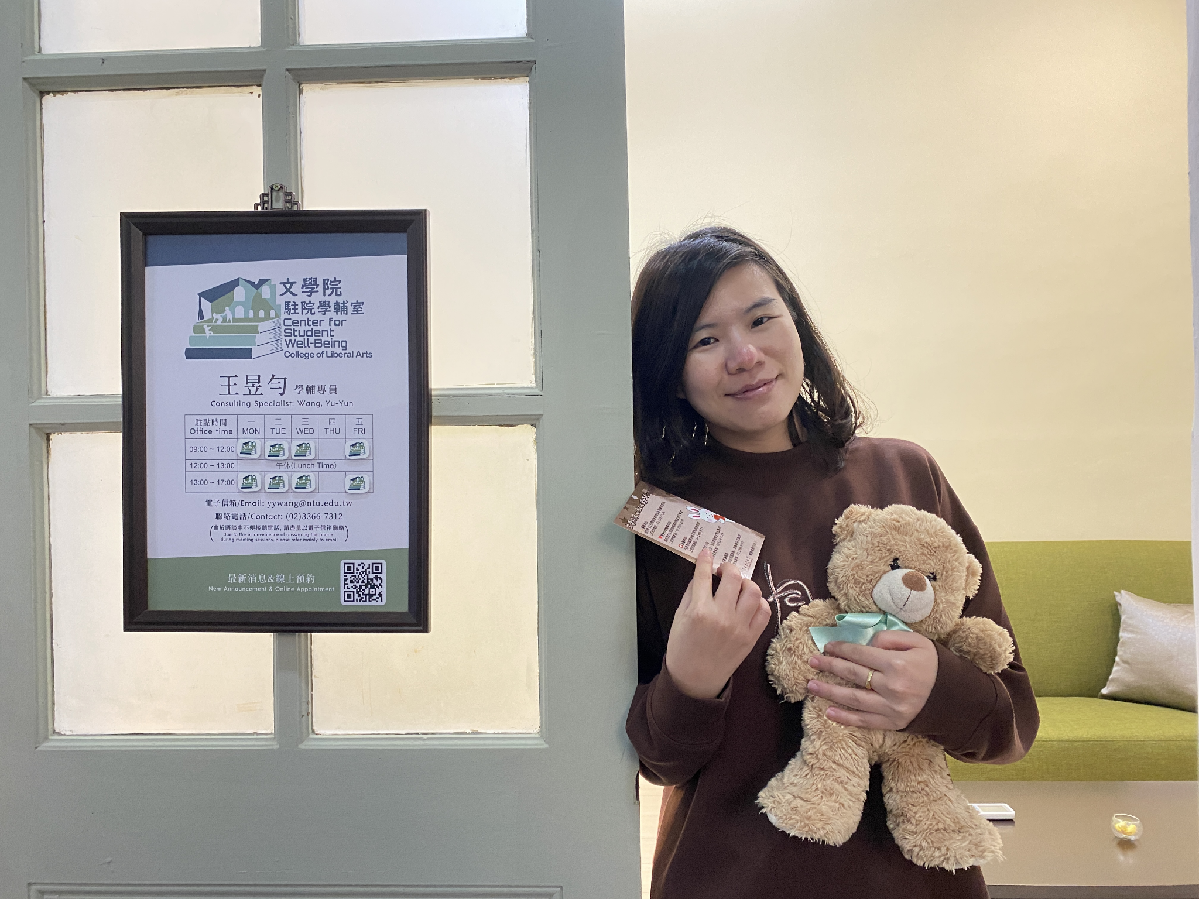

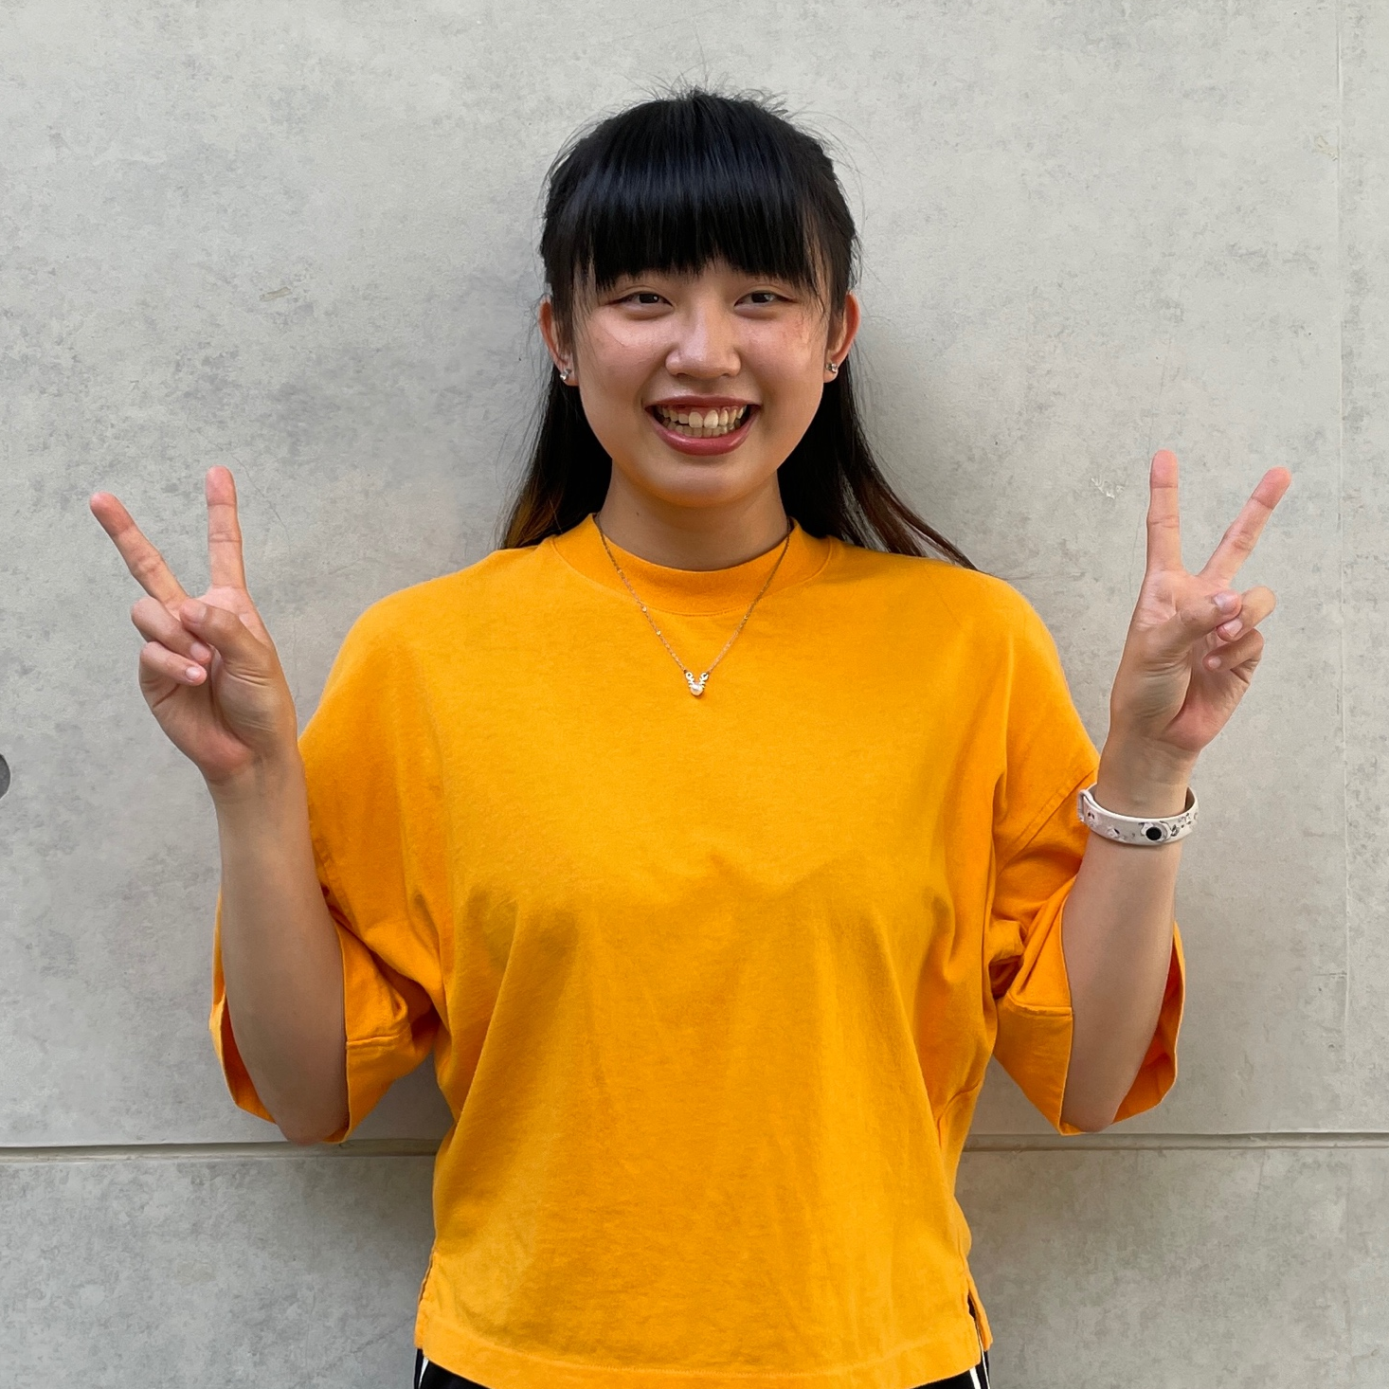

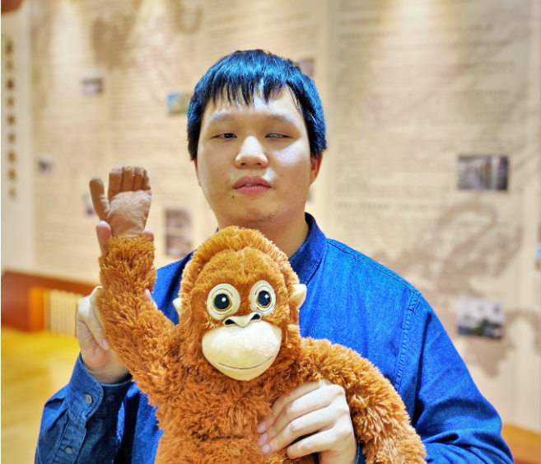

Center for Student Well-being Student Safety Center
Yu-Yun Wang consulting specialist
Location: 1F, College of Liberal Arts
Office hours:
Mon., Tue., Wed., Fri. 09:00-17:00
TEL: 3366-7312
E-mail: yywang@ntu.edu.tw
Bo-Ting Lee Senior Clerk
TEL: 3366-2054
E-mail: leeboting1097@ntu.edu.tw
Liberal Arts
Yun-Chi Hsu consulting specialist
Location: Room B02-2, B1, Shih - Liang Hall
Office hours:
Mon., Tue., Wed., Fri. 09:00-17:00
TEL: 3366-3366 ext.26517
E-mail: yunchi@ntu.edu.tw
Ching-Ling Kuo Senior Clerk
TEL: 3366-2056
E-mail: kuochingling@ntu.edu.tw
Science
Social Science
Pei-Ken Wang consulting specialist
Location: 4F, College of social Sciences Building
Office hours: Mon.& Fri. 09:00-17:00
TEL: 3366-7313
E-mail: wangpeiken@ntu.edu.tw
Wen-Chun Peng Senior Clerk
TEL: 3366-2061
E-mail: bensonpeng@ntu.edu.tw
Notes:
The next pages are the members of Center for Student Well-being and Student Safety Center.
And each of us is in charge of different college.
We work as a team to support students’ life in NTU and make sure of students‘ safety and well-being.
If you face any difficulty in campus, you can find consulting specialist in your college or member in student safety center.

Slide 8
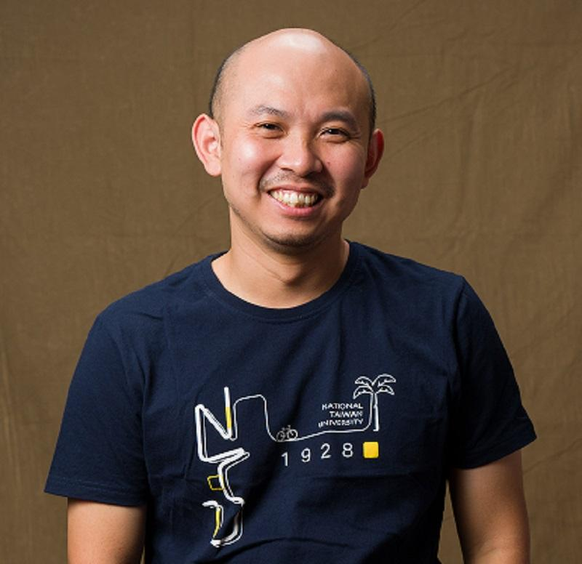

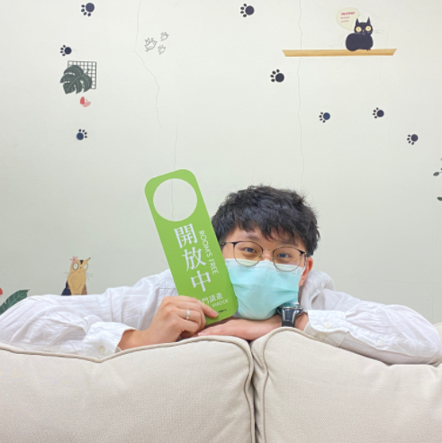

Center for Student Well-being Student Safety Center
Chien-Chang Wu Associate Manager
TEL: 3366-2060
E-mail: jackywu711007@ntu.edu.tw
Medicine
Engineering
Jui-Kun Chang Senior Clerk
TEL: 3366-2057
E-mail: changjuikun@ntu.edu.tw
Bioresources
& Agriculture
Chia-Yu Wang consulting specialist
Location: Room B07, B1, Building 3, Dept. of Veterinary Medicine
Office hours: Tue. & Fri. 09:00-17:00
TEL: 3366-7314
E-mail: cywang123@ntu.edu.tw
Chin-Sen Kuo Senior Clerk
TEL: 3366-2059
E-mail：chinsen@ntu.edu.tw

Slide 9

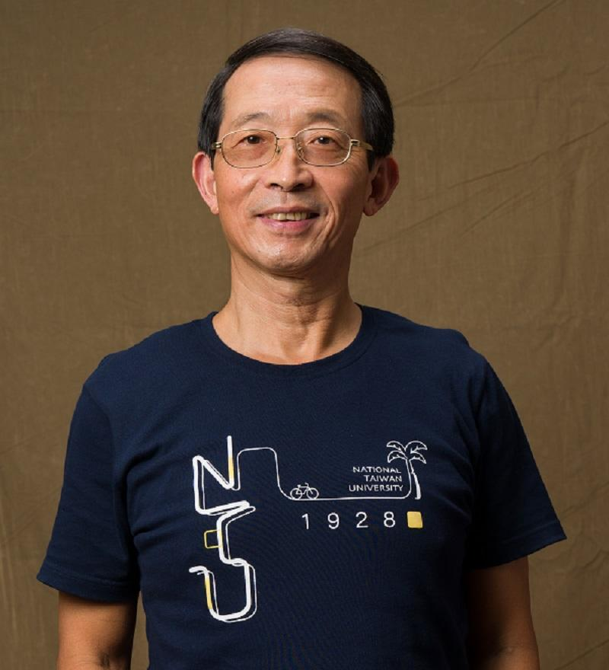
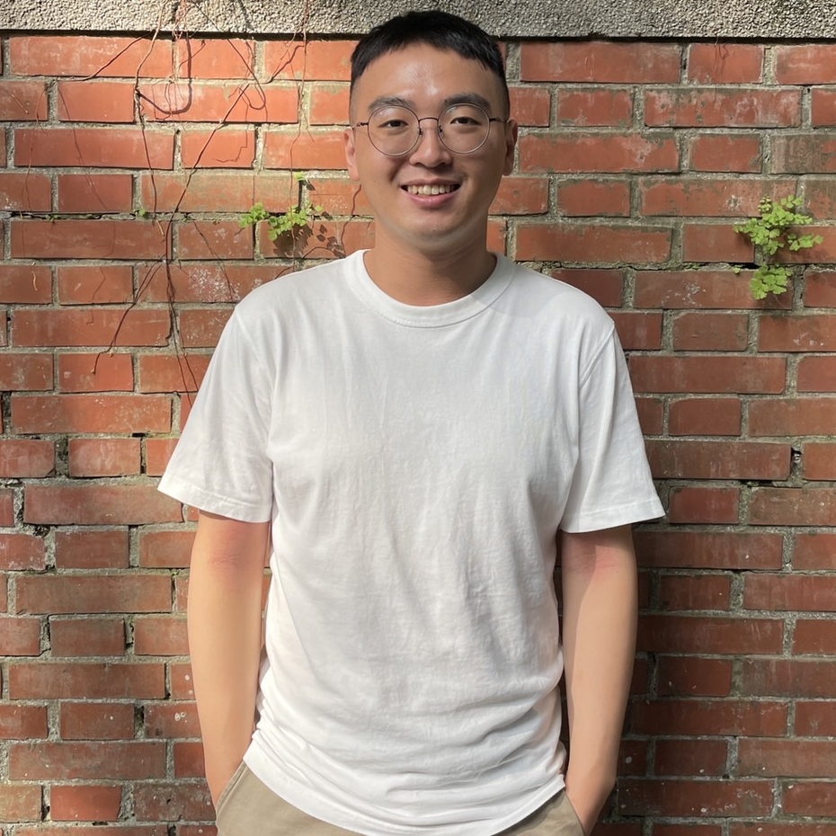
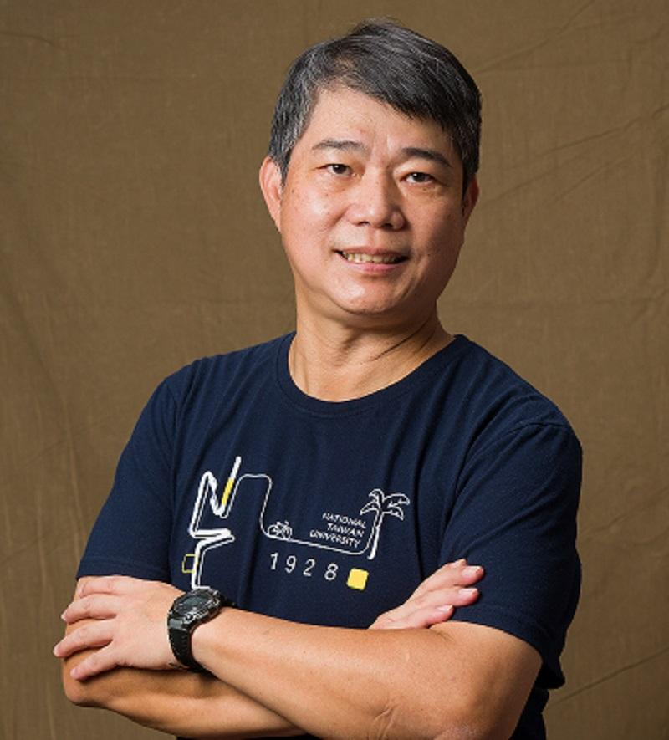
Center for Student Well-being Student Safety Center
Management
Yu-Hao Tseng Consulting Specialist
Location: Room B106, B1, Building 1, College of Management
Office hours:
Mon., Tue.,Wed., Fri. 09:00-17:00
TEL: 3366-9017
E-mail: yhtseng1111@ntu.edu.tw
Jun-Sheng Wang Senior Clerk
TEL: 3366-2056
E-mail: rsw@ntu.edu.tw
Pubic Health
Chien-Chang Wu Associate Manager
TEL: 3366-2060
E-mail: jackywu711007@ntu.edu.tw
Electrical Engineering
& computer science
Tzu-Ming Lin Consulting Specialist
Location: 7F, Barry Lam Hall
Office hours:
Mon., Tue., Wed., Fri. 09:00-17:00
TEL: 3366-1929
E-mail: minglin@ntu.edu.tw
Chih-Wen Chou Manager and Chief
TEL: 3366-2055
E-mail: jjw@ntu.edu.tw

Slide 10
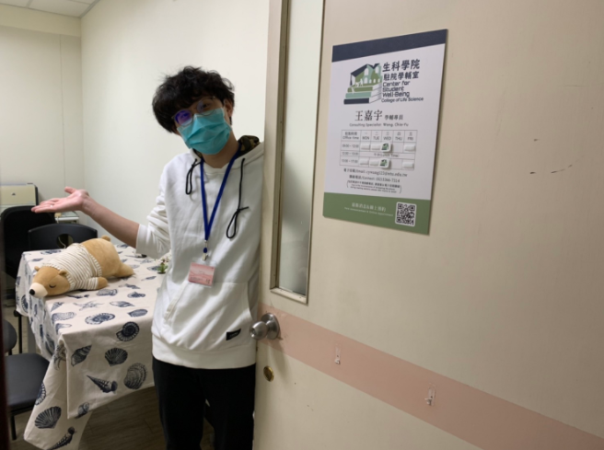
Center for Student Well-being Student Safety Center
Pei-Ken Wang consulting specialist
Location: 1F, Tsai Lecture Hall
Office hours: Tue. & Wed. 09:00-17:00
TEL: 3366-7313
E-mail: wangpeiken@ntu.edu.tw
Bo-Ting Lee Senior Clerk
TEL: 3366-2054
E-mail: leeboting1097@ntu.edu.tw
Law
Life Science
Chia-Yu Wang consulting specialist
Location: R215, 2F, New Agricultural Chemistry Building
Office hours: Wed. 09:00-17:00
TEL: 3366-7314
E-mail: cywang123@ntu.edu.tw
Wen-Chun Peng Senior Clerk
TEL: 3366-2061
E-mail: bensonpeng@ntu.edu.tw

Slide 11
If you have any problem, feel free to call us!
Hotlines in NTU 24hrs/7days
  Student Safety Center: 02-3366-9119
  Campus Security: 02-3366-9110
Hotlines in NTU during working time (Mon.-Fri. 08:00-17:00)
  Office of International Affairs: 02-3366-2007
  Center for Student Well-being: 02-3366-7173
  Student Counseling Center: 02-3366-2181 #222
  Health Center: 02-3366-9595
Life Consultation Hotline for Foreign Nationals Living in Taiwan: 1990
Notes:
If you have any problem, of course, you can contact office of international affair first.
They will help you to get what you need.
Or you can just contact us or other centers in campus directly.
Student safety center and campus security work for 24 hours.
They could help you deal with the emergency situation.
Taiwan government also provides life consultation hotline for foreign nationals.
The number is 1990.
And it provides Mandarin, English, and Japanese service for 24 hours.

Slide 12
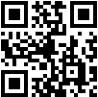
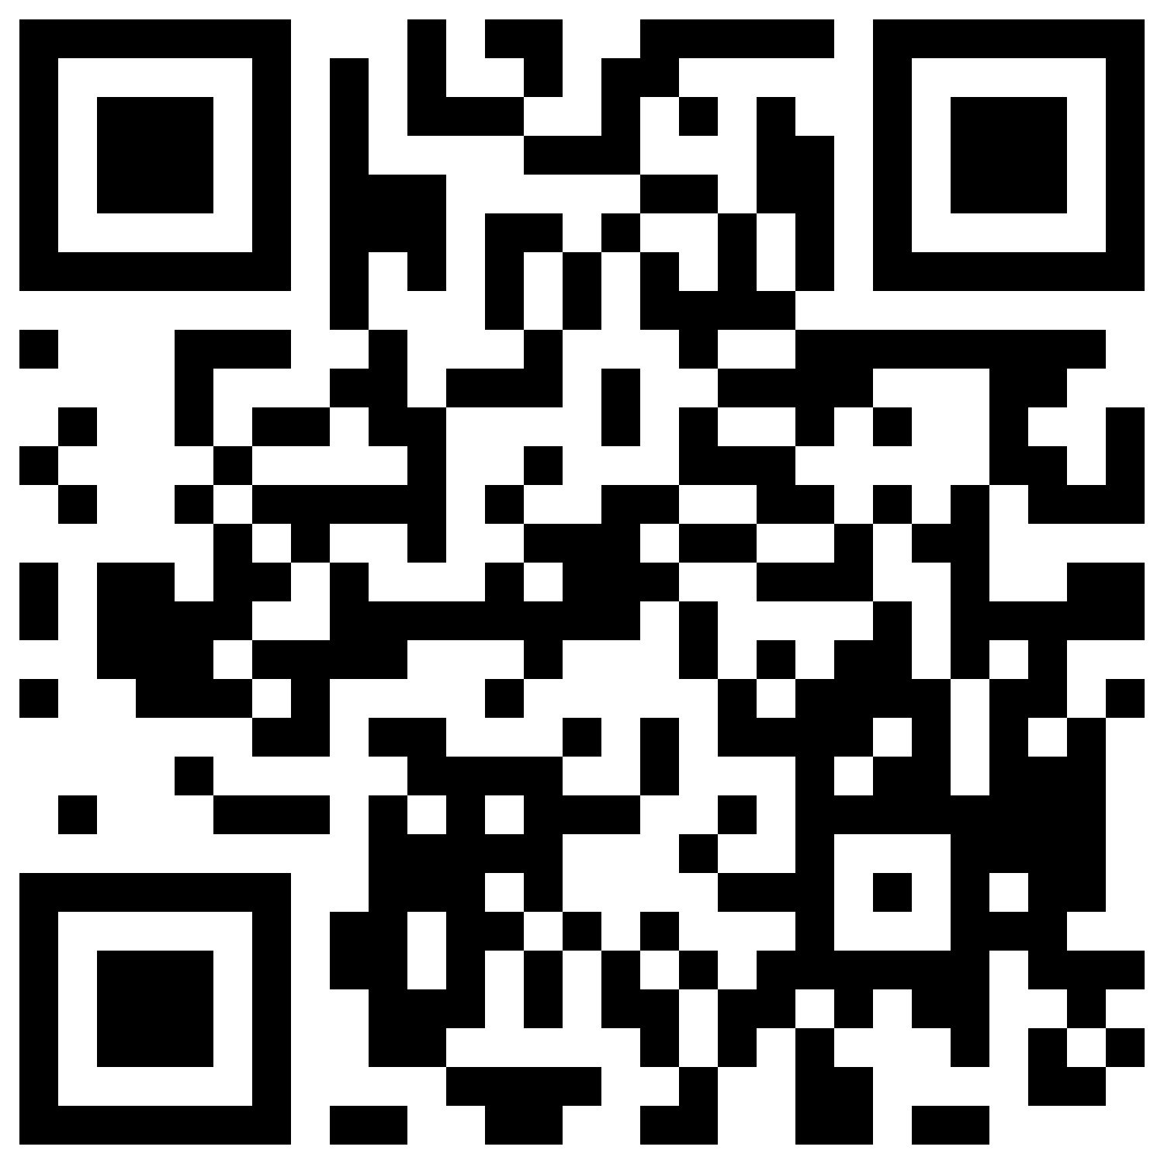
Contact us
Website of Center for Student Well-being
Location of Center for Student Well-being & Student Safety Center
Wish you a wonderful journey in NTU!
Any Question?

